Slide 1

Differentiable programming for modeling and control of energy systems
The Fifth Autonomous Energy Systems Workshop NREL, Golden, CO
Ján Drgoňa Collaborators: Aaron Tuor, Shrirang Abhyankar, Ethan King, James Koch, Zhao Chen, Soumya Vasisht, Vikas Chandan, Draguna Vrabie

Slide 2

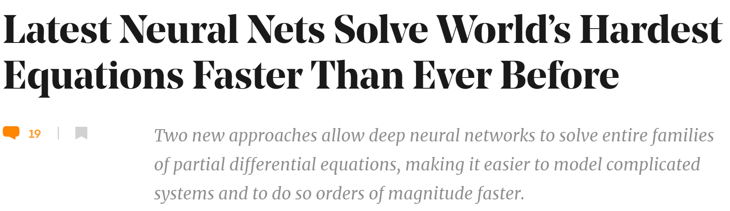

Challenge 1: Systems Modeling
Simulations are crucial for many areas of decision-making and scientific discovery
Need: Improve computational efficiency and scalability for heterogenous scientific simulations
Objectives:
Domain-agnostic software and algorithmic framework
Scientific computing enhanced by data science
Algorithmic speedups enhanced with HPC
Applications: Optimization, modeling and control of dynamical systems (ODE, PDE, DAE, Hybrid systems)

Slide 3
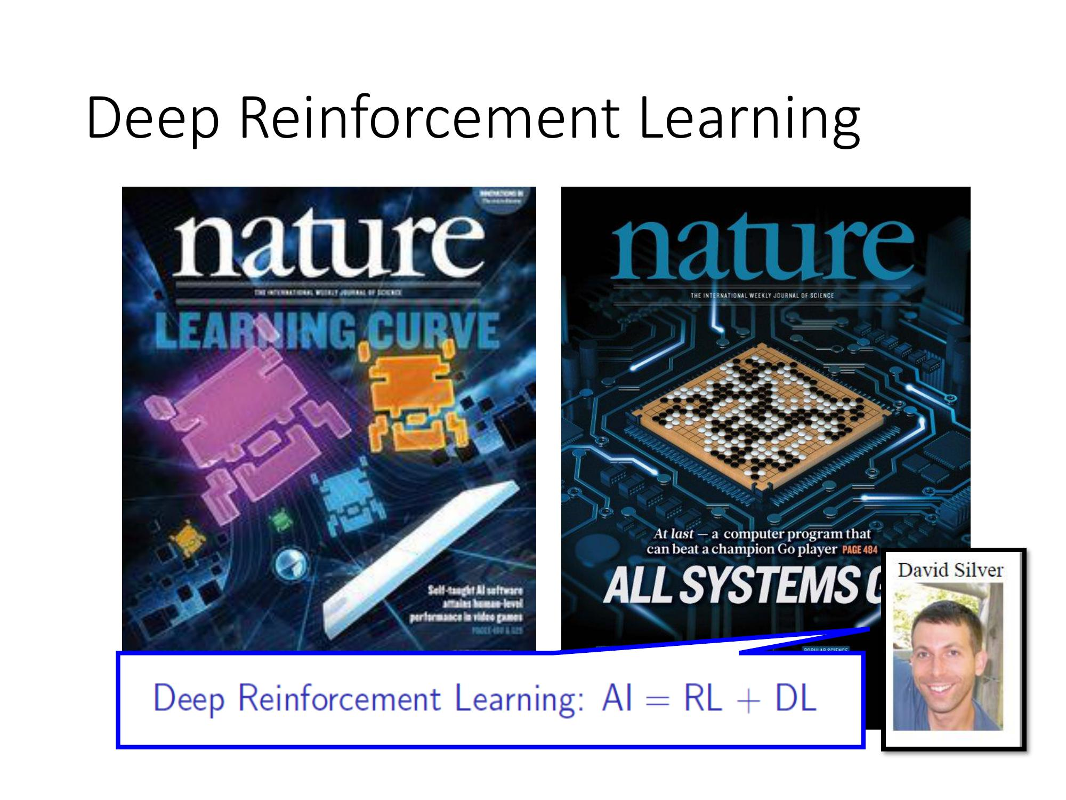
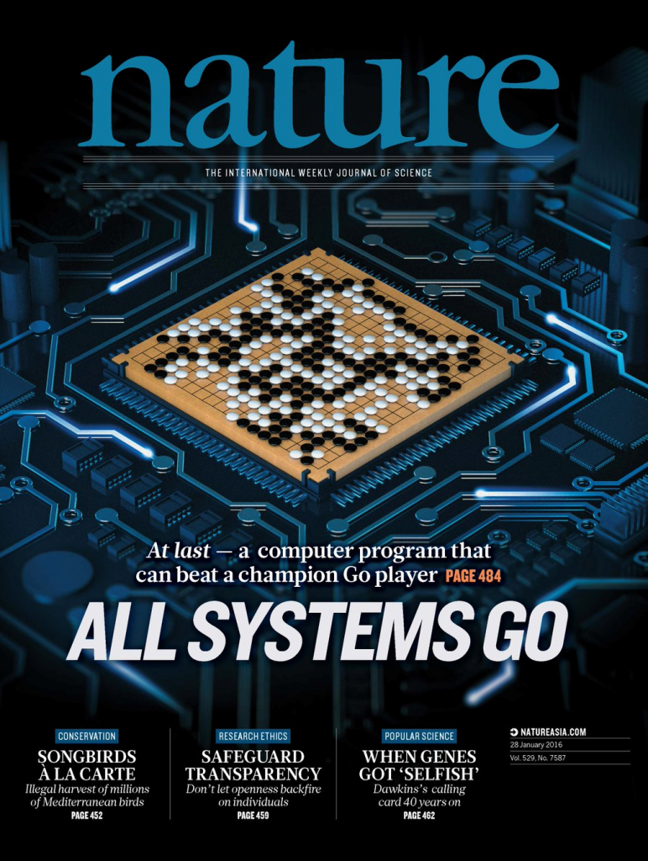
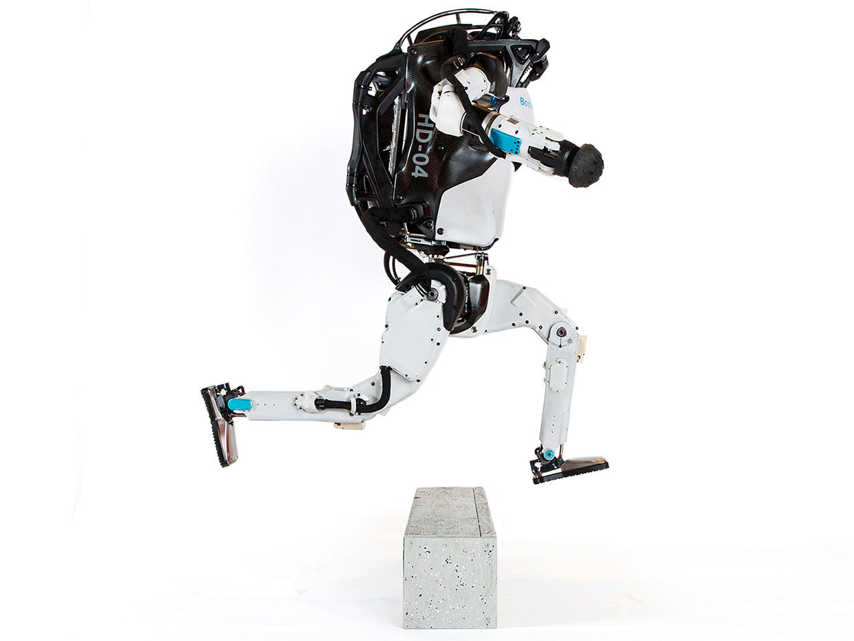
Challenge 2: Systems Control
Model Predictive Control
Reinforcement Learning
95% of the industrial control applications are PID loops & expert driven rule-based control (RBC).
The rest is model predictive control (MPC).
Everywhere where you have reliable digital environment model, mostly discrete action space, and you can use massive compute to solve the problem.
Drgona J., J. Arroyo, I.C. Figueroa, D. Blum, K. Arendt, D. Kim, and E.P. Olle, J. Oravec, M. Wetter, D. L. Vrabie, L. Helsen. 2020. "All You Need to Know About Model Predictive Control for Buildings." Annual Reviews in Control, September 29, 2020
G. Dulac-Arnold, D. J. Mankowitz, and T. Hester, “Challenges of real-world reinforcement learning,”, 2019. http://arxiv.org/abs/1904.12901

Slide 4

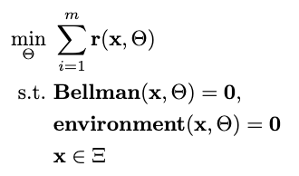

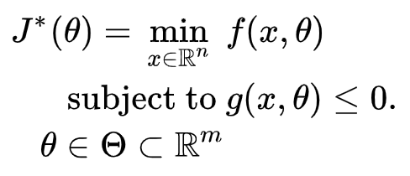

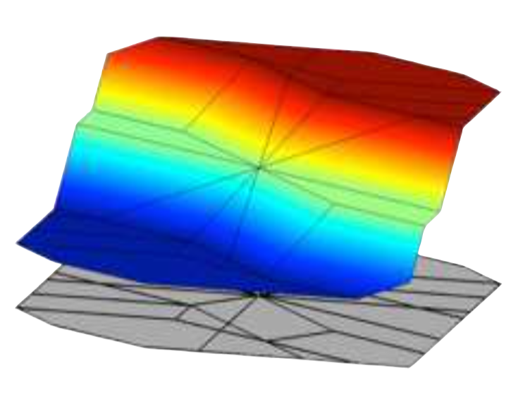
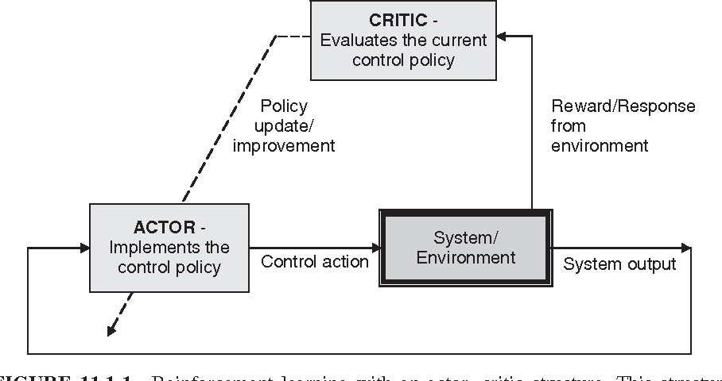

Landscape of Optimization Methods
Online optimization
Parametric programming
Imitation Learning
Reinforcement Learning
“online” solution for given parameter values
computationally demanding in real-time
“offline” optimization obtains a solution map
classical methods lead to exponential complexity!
“offline” optimization
obtains a model (map)
scalable but requires expert controller
“offline” optimization
obtains a policy map
classically can’t handle constraints

Slide 5
Landscape of Optimization Methods
Online optimization
Parametric programming
Imitation Learning
Reinforcement Learning
“online” solution for given parameter values
computationally demanding in real-time
“offline” optimization obtains a solution map
classical methods lead to exponential complexity!
“offline” optimization
obtains a model (map)
scalable but requires expert controller
“offline” optimization
obtains a policy map
classically can’t handle constraints
Differentiable parametric programming (DPP): a unifying approach for data-driven parametric programming optimization with solutions based on automatic differentiation (AD)

Slide 6
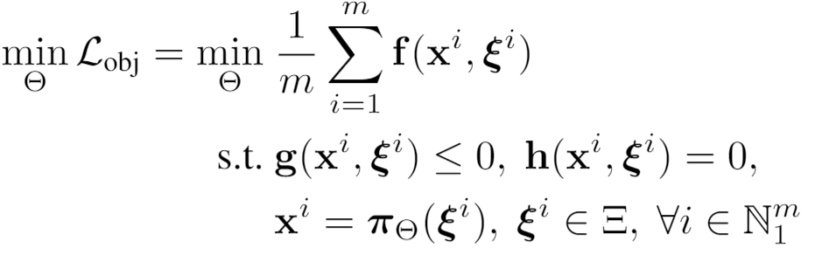
Differentiable Parametric Programming: Generalization of PINNs
Problem formulation:

Slide 7
Differentiable Parametric Programming: Generalization of PINNs
Objective function
Problem formulation:
Constraints
Primal optimizers
Scenarios
Solution map
Parameters

Slide 8
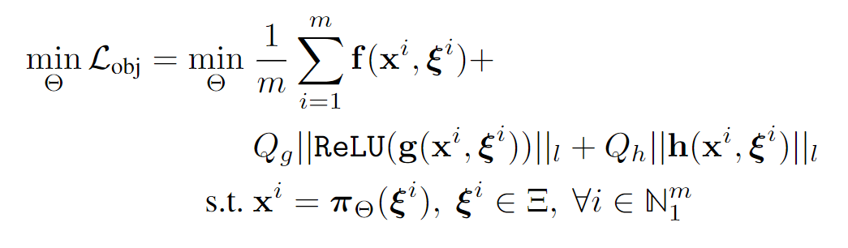
Differentiable Parametric Programming: Generalization of PINNs
Objective function
Problem formulation:
Constraints
Primal optimizers
Scenarios
Solution map
Parameters
Lagrangian form:
Constraints penalties
Gradient-based optimization based on AD

Slide 9

Differentiable Parametric Programming: NeuroMANCER toolbox
train_data, dev_data, test_data = get_dataloaders(samples)
p = Variable(‘p’) # sampled parameter
x = Variable(‘x’) # decision variable
y = Variable('y’) # decision variable
map = nm.MLP(input_keys=['p’], output_keys=[‘x’,‘y’], name='map’)
# parametric solution map
f = x ** 2 + y ** 2 obj = f.minimize(weight=Q, name='obj’) # objective function con_1 = Q_con*(-x - y + p <= 0) # constraint
con_2 = Q_con*(-x + y + p <= 0) # constraint
objectives = [obj]
constraints = [con_1, con_2] components = [map]
loss = PenaltyLoss(objectives, constraints, train_data) problem = Problem(components, loss) # differentiable optimization optimizer = torch.optim.AdamW(problem.parameters(), lr=args.lr) trainer = Trainer(problem,train_data,dev_data,test_data,optimizer)
best_model = trainer.train()
Neural Modules with Adaptive Nonlinear Constraints and Efficient Regularizations
https://github.com/pnnl/neuromancer

Slide 10
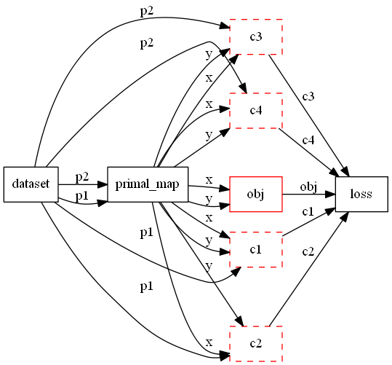
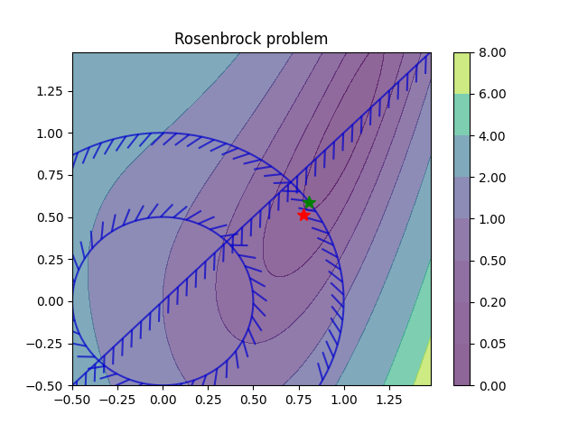
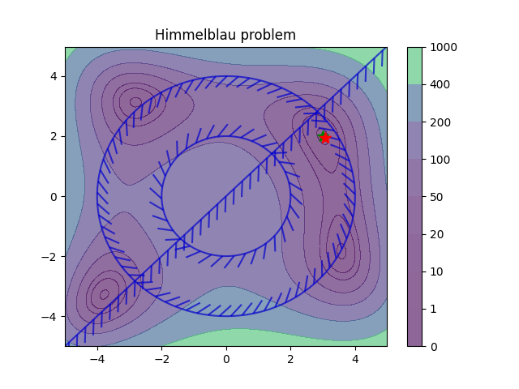
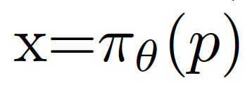
Differentiable Parametric Programming: Computational Graphs
Parametric nonlinear programs
Orders of magnitude faster online solution compared to online optimization solvers (IPOPT).

Slide 11
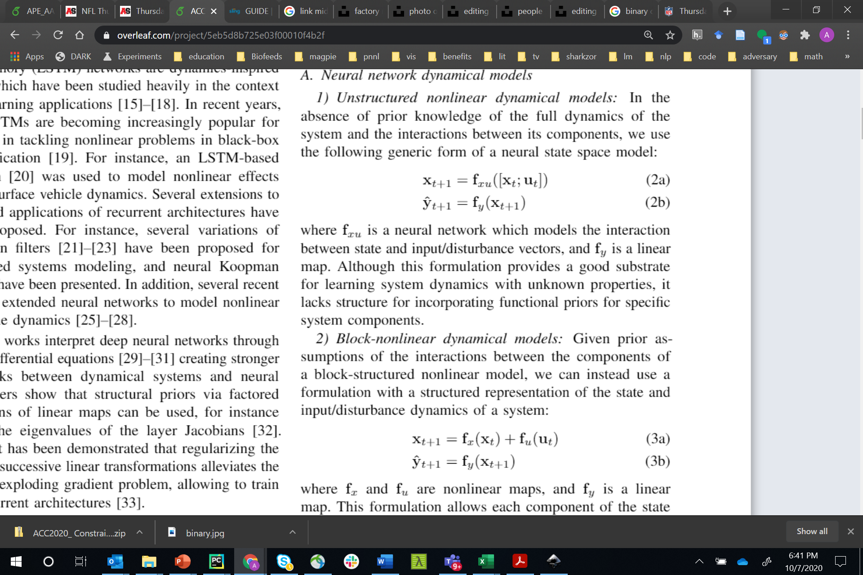
Neural State Space Models
x_{t}
f_{x}
x_{t+1}
f_{y}
x₀
+
y_{t+1}
f_{x}
f_{y}
f_{u}
f_{x}
f_{y}
+
u_{t}
f_{u}
f_{u}
f_{u} o f_{y} = I
Linear
Hammerstein
Koopman
x_{t}
x_{t+1}
y_{t+1}
f_{x}
f_{y}
f_{x}
f_{y}
f_{xu}
f_{y}
+
+
u_{t}
f_{u}
f_{u}
Block-Nonlinear
Unstructured
Hammerstein-Weiner
Linear map
Non-Linear map

Slide 12
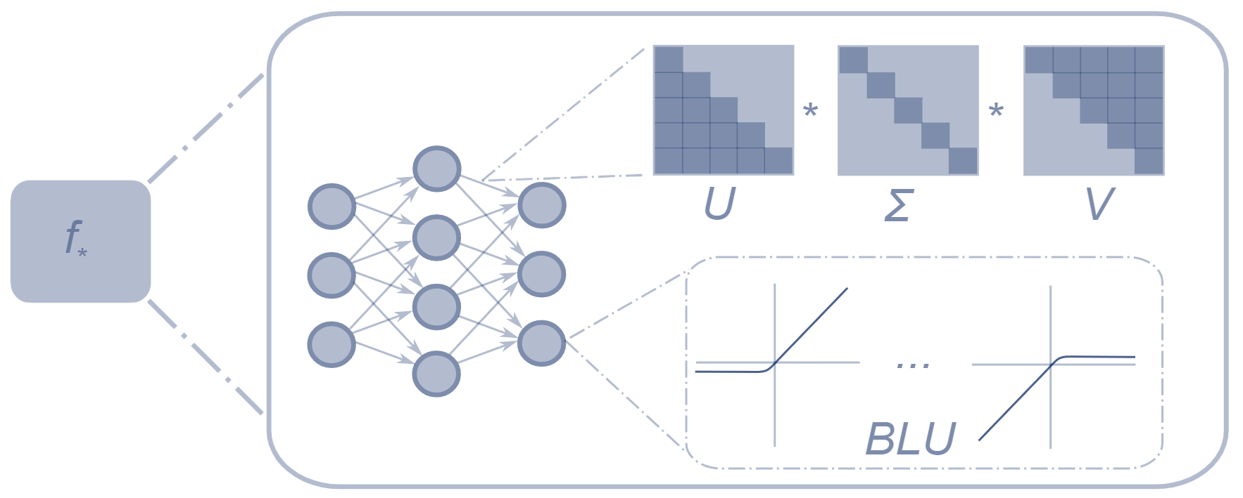
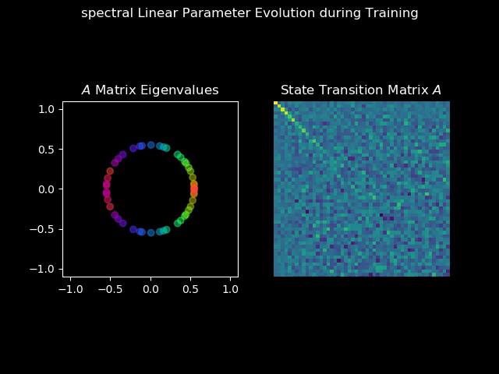
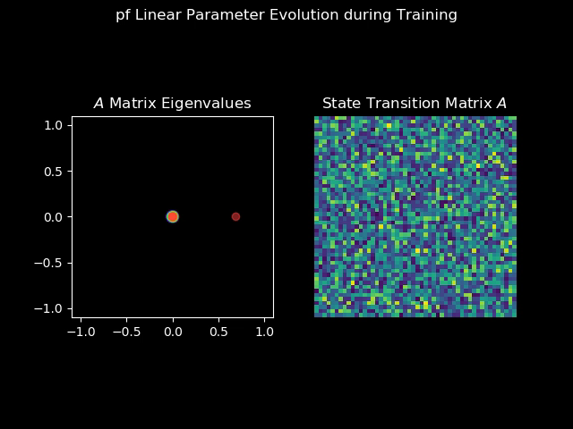
Bottom-Up Approach: Structured Linear Maps (SLiM)
Factorizations and regularizations of linear maps with predetermined structure
Can be used to enforce sparsity or spectral properties
https://github.com/pnnl/slim
Spectral map
Perron-Frobenius map

Slide 13
Modeling Thermal Dynamics
Ján Drgona, et al., Physics-constrained deep learning of multi-zone building thermal dynamics, Energy and Buildings, 2021

Slide 14
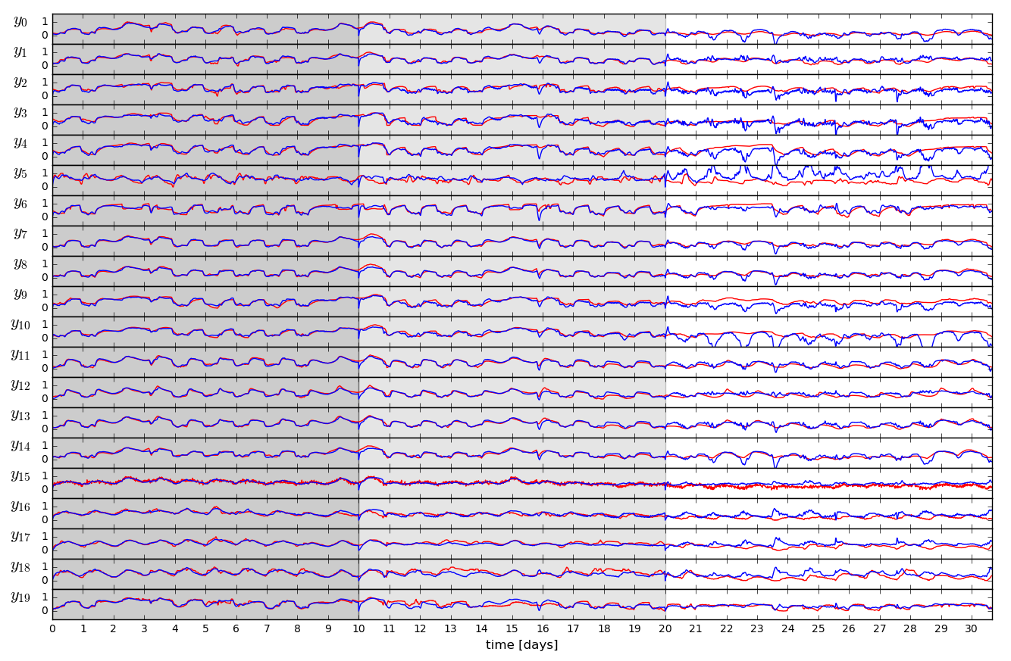
Open-loop Trajectories of Linear Model

Slide 15
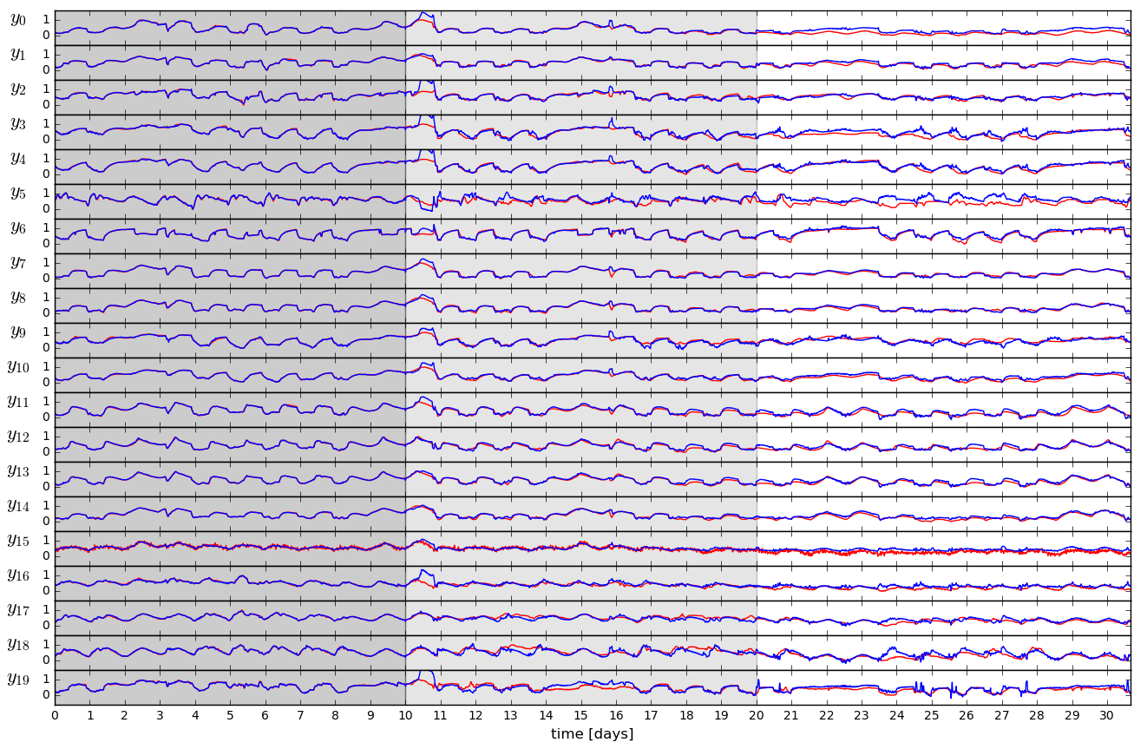
Open-loop Trajectories of Neural Model

Slide 16
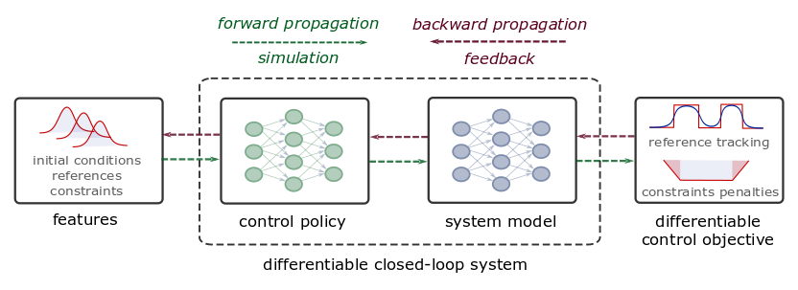
Differentiable Predictive Control
Constrained Model-based Policy Optimization for Parametric Optimal Control
Jan Drgona, Aaron Tuor, Draguna Vrabie, Learning Constrained Adaptive Differentiable Predictive Control Policies With Guarantees, 2021,
https://arxiv.org/abs/2004.11184
Jan Drgona, et al., Differentiable Predictive Control: An MPC Alternative for Unknown Nonlinear Systems using Constrained Deep Learning, Journal of Process Control, 2022, https://arxiv.org/abs/2011.03699

Slide 17
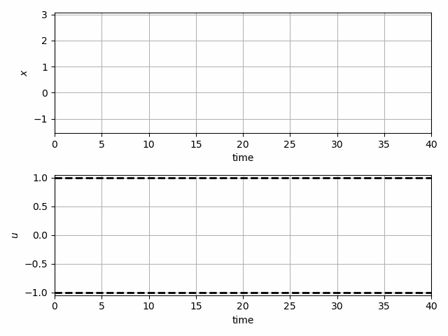
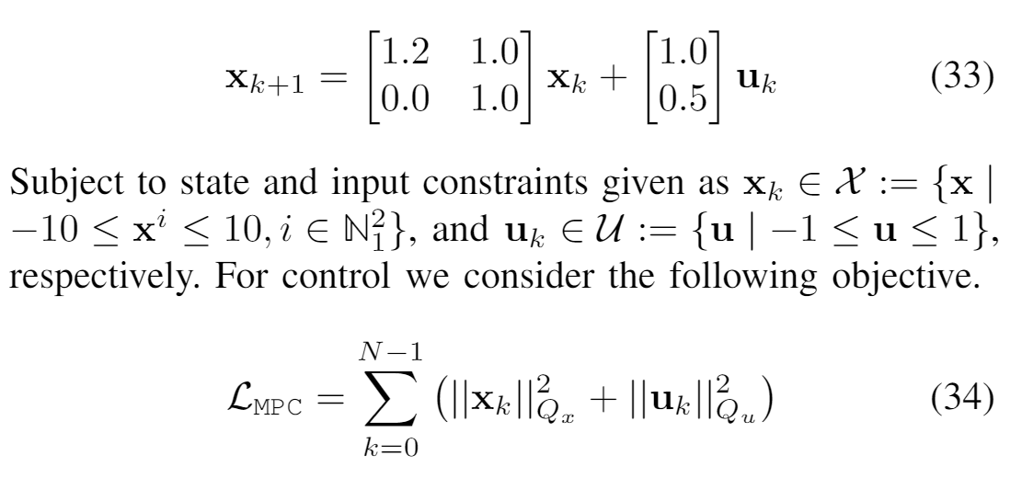
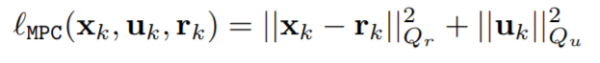
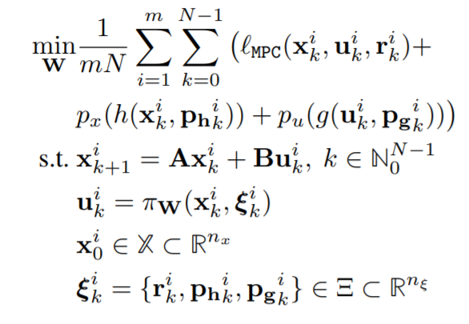
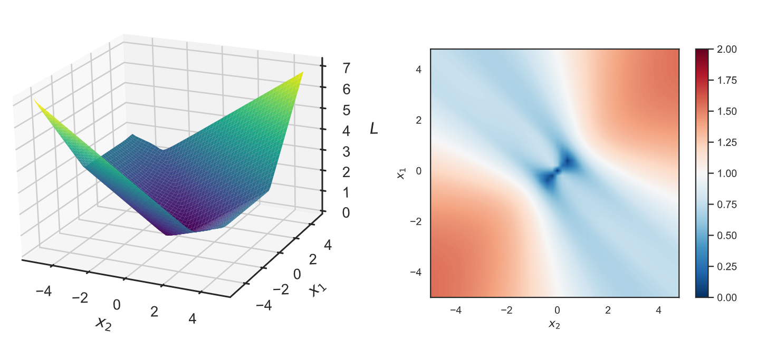
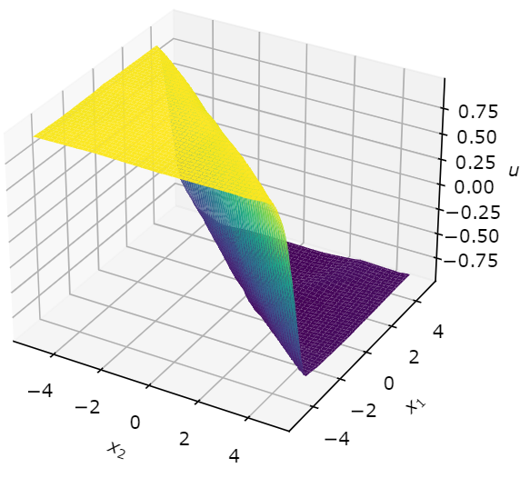
Learning to Stabilize Unstable System
Problem setup:
DPC formulation:
Jan Drgona, Aaron Tuor, Draguna Vrabie, Learning Constrained Adaptive Differentiable Predictive Control Policies With Guarantees, https://arxiv.org/abs/2004.11184

Slide 18
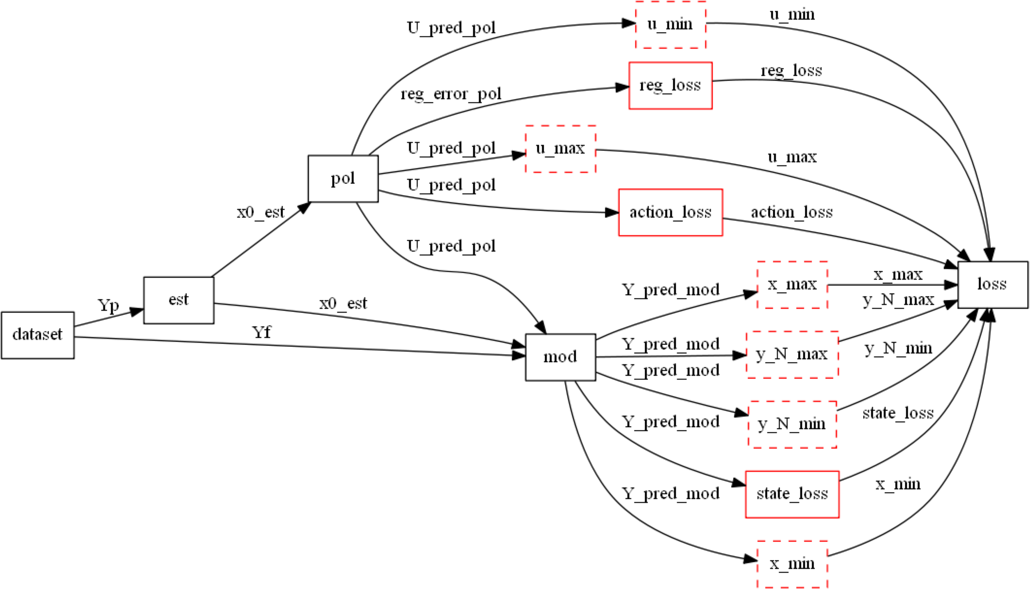
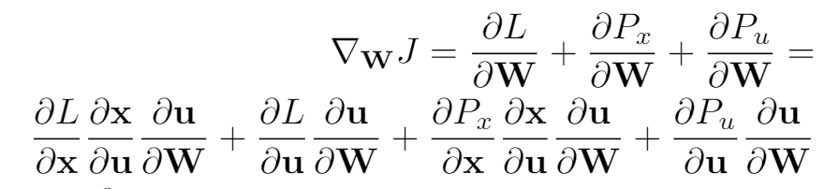
Differentiable Computational Graphs and Model-based Policy Gradients
Differentiate the computational graph to train the policies using state-of-the-art deep learning practice.

Slide 19
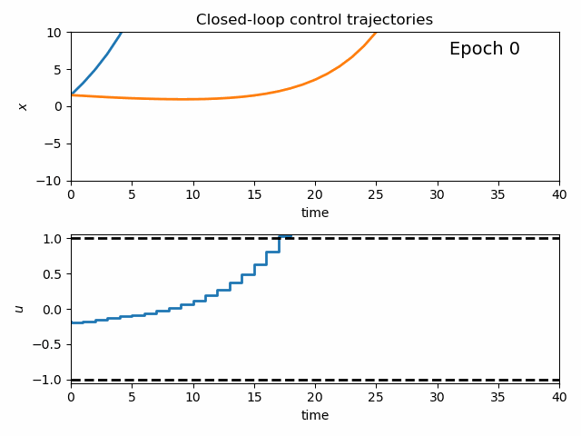
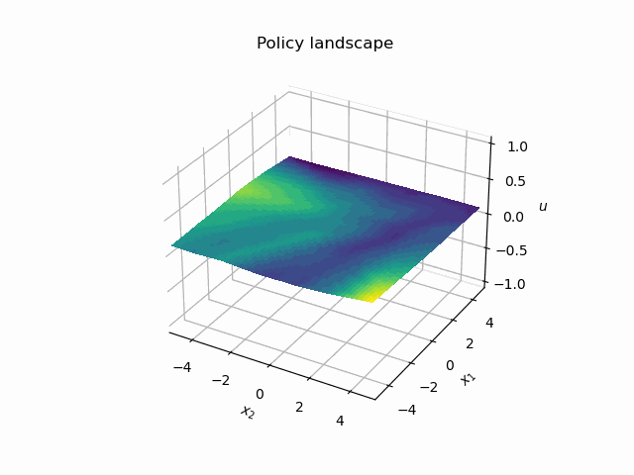
Dynamics of DPC Control Policy Learning
1341 learning parameters, 48.2 seconds offline training time on a CPU with 200 epochs.
Jan Drgona, Aaron Tuor, Draguna Vrabie, Learning Constrained Adaptive Differentiable Predictive Control Policies With Guarantees, https://arxiv.org/abs/2004.11184

Slide 20
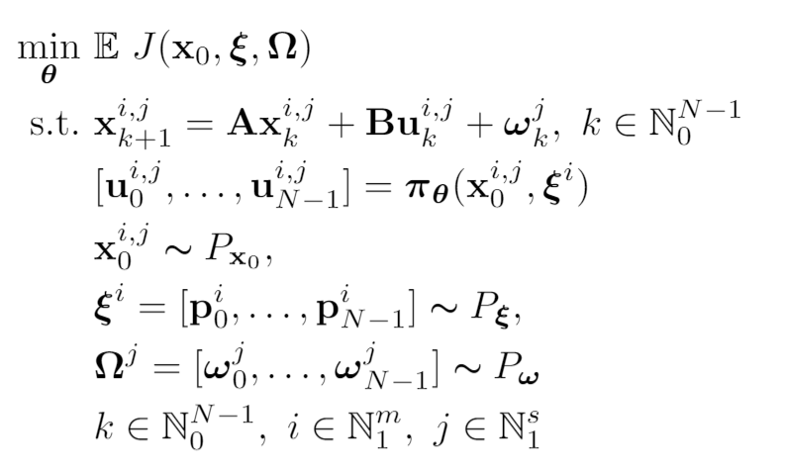
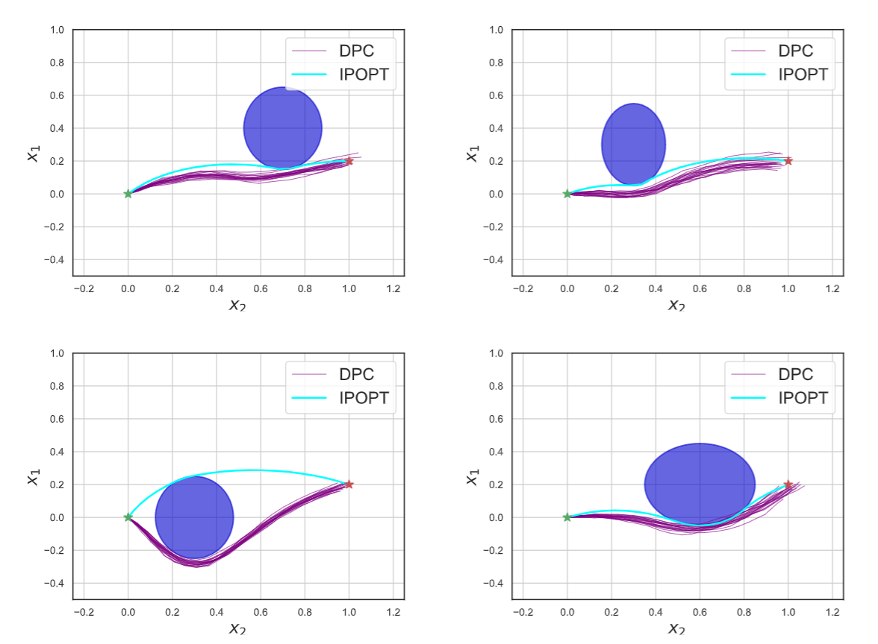
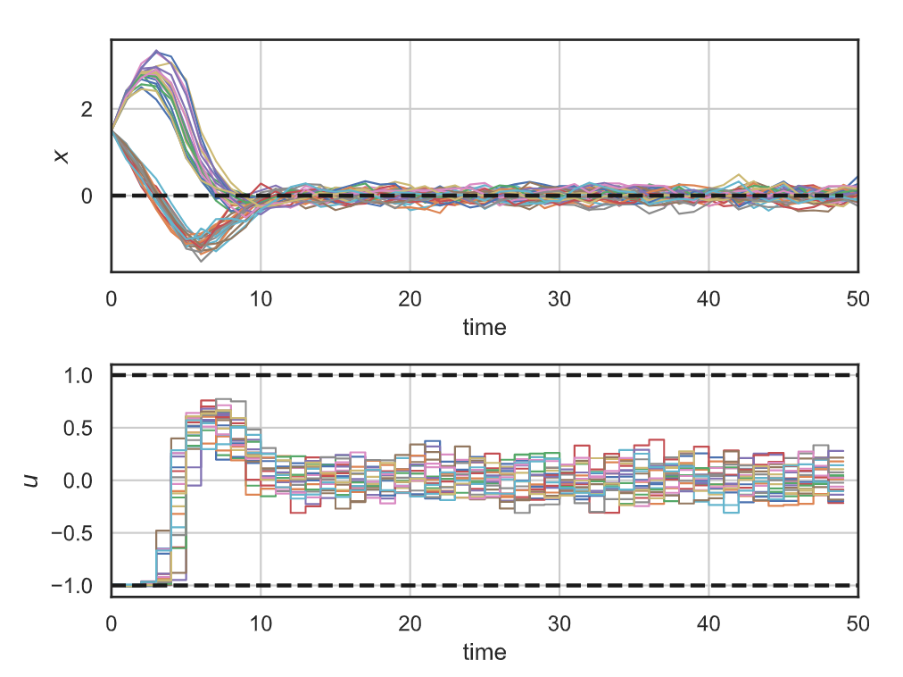
Stochastic Differentiable Predictive Control
Stochastic obstacle avoidance
Stochastic
formulation
Parameters
Uncertainties
Robustness
to state noise
Jan Drgona, Sayak Mukherjee, Aaron Tuor, Mahantesh Halappanavar, Draguna Vrabie, Learning Stochastic Parametric Differentiable Predictive Control Policies, arXiv:2203.01447, to appear at IFAC ROCOND 2022

Slide 21


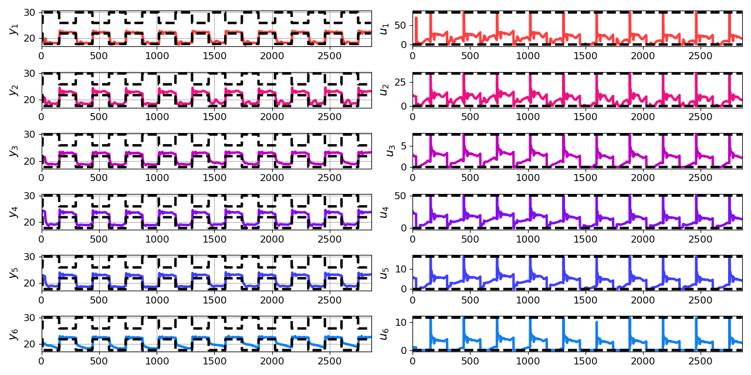
Economic Differentiable Predictive Control of Building Energy System
Architectures
Neural state space dynamics model
MLP control policy architecture
Domain-aware constraints
Results
Multi-input multi-output system dynamics
Dynamic economic control objective
Parametric constraints
Jan Drgona, Aaron Tuor, Elliott Skomski, Soumya Vasisht, Draguna Vrabie, Deep Learning Explicit Differentiable Predictive Control Laws for Buildings, IFAC NMPC 2021

Slide 22
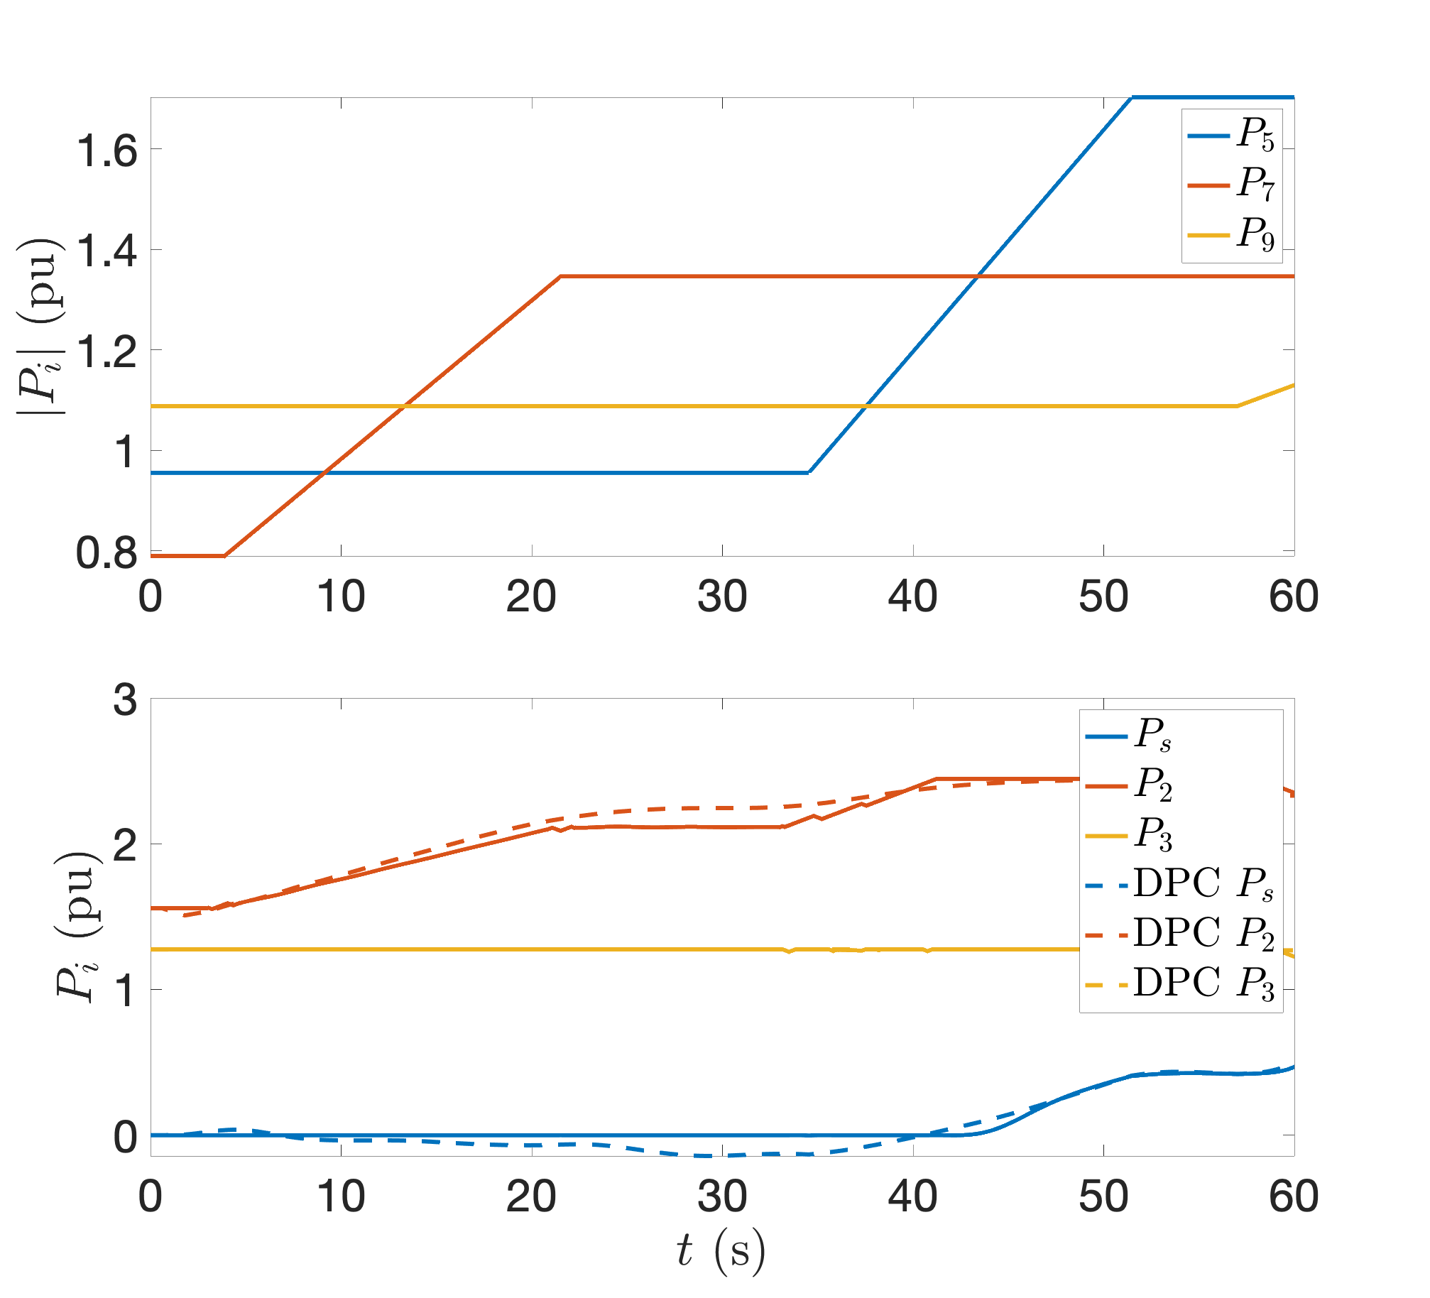
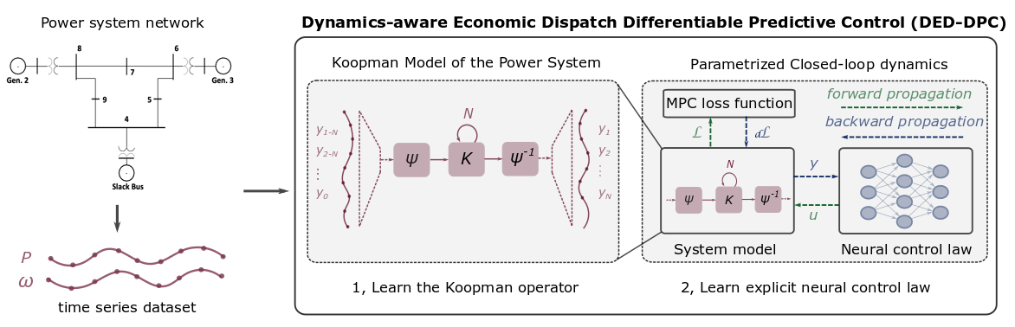
Dynamics-Aware Economic Redispatch via Differentiable Predictive Control
Problem: Current redispatch processes do not incorporate system dynamics concerns. Incorporating dynamics in redispatch is too complex and/or time-consuming
Architectures
Koopman dynamics model
CNN control policy
Solution: Machine-learning based dynamics-aware redispatch. Learn system dynamics for faster assessment.
Results
5 orders of magnitude speed-up
Minimal loss in solution quality
Ethan King, Ján Drgoňa, Aaron Tuor, Shrirang Abhyankar, Craig Bakker, Arnab Bhattacharya, Draguna Vrabie, Koopman-based Differentiable Predictive Control for the Dynamics-Aware Economic Dispatch Problem, The 2022 American Control Conference

Slide 23
Embedded Implementation of DPC
Flexy-Air system sketch with Raspberry-Pi controller
Performance comparison: reference (red dashed), position controlled with PI controller (green), explicit model predictive control (purple), constrained differentiable predictive control (blue) and constraints (black-dashed). Bottom figures show the fan speed controls
Jan Drgona, Karol Kis, Aaron Tuor, Draguna Vrabie, Martin Klauco, Differentiable Predictive Control: An MPC Alternative for Unknown Nonlinear Systems using Constrained Deep Learning; Journal of Process Control, 2022

Slide 24
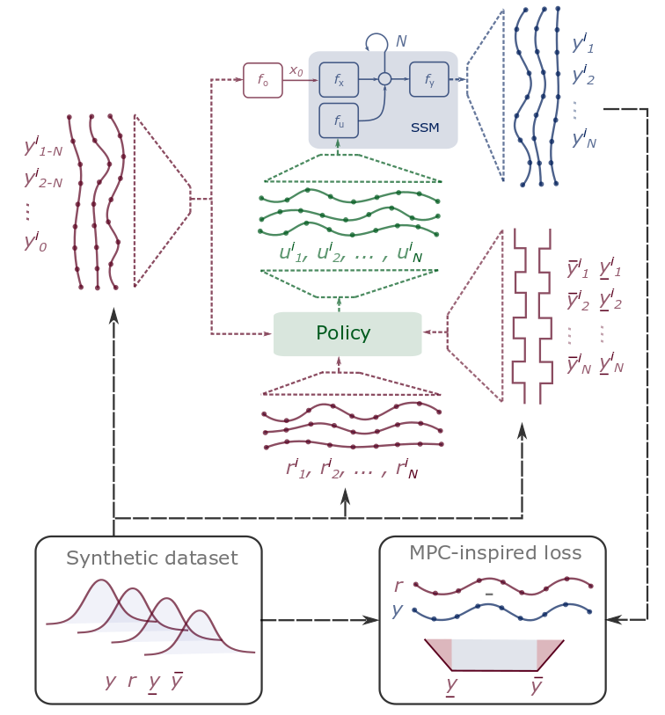
Conclusion
SciML Methods
Differentiable programming
Parametric programming
Constrained optimization
Dynamical modeling and control
Ongoing work
Constrained optimization solvers
Graph neural networks (GNNs)
Uncertainty Quantification (UQ)
Long-Term Vision
Causal discovery, dynamical coupling, sensitivity, structure, and stability analysis, machine reasoning
Solving large-scale parametric constrained optimization problems
https://github.com/pnnl/neuromancer
https://github.com/pnnl/slim

Slide 25
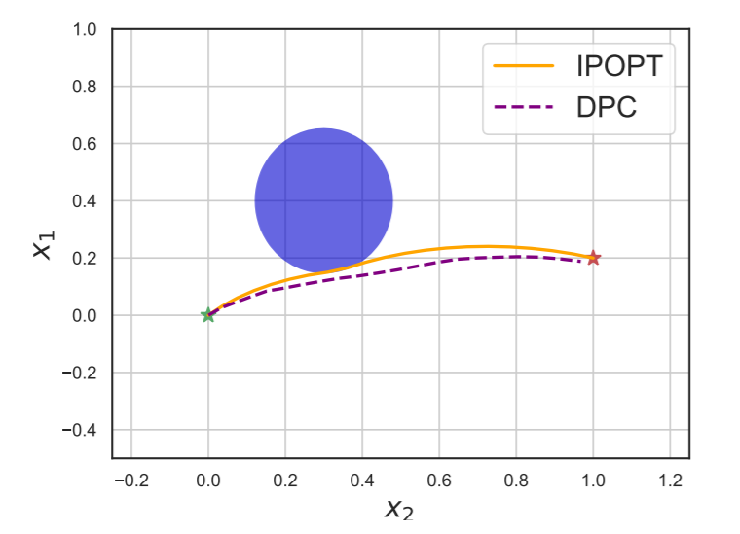
NeuroMANCER
Open-source scientific machine learning (SciML) toolbox in Python for integrating deep learning, constrained optimization, and physics-based modeling
Differentiable constrained optimization
Parametric nonlinear programs (pNLP)
Constrained machine learning
Classical deep learning (RNN, MLP, ResNet)
Graph neural nets (GNNs)
Physics-informed modeling of dynamic systems
Neural state space models (NSSM)
Neural ordinary differential equations (NODE)
Constrained control of dynamic systems
Differentiable predictive control (DPC)
https://github.com/pnnl/neuromancer/tree/master/examples

Slide 26
Additional details on Neuromancer Technology

Slide 27
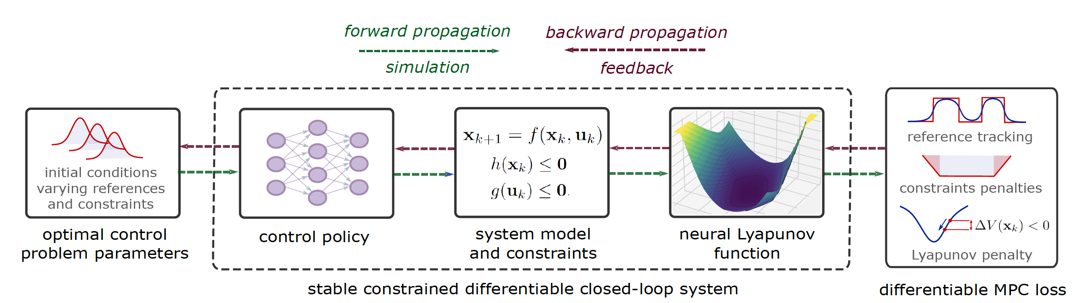
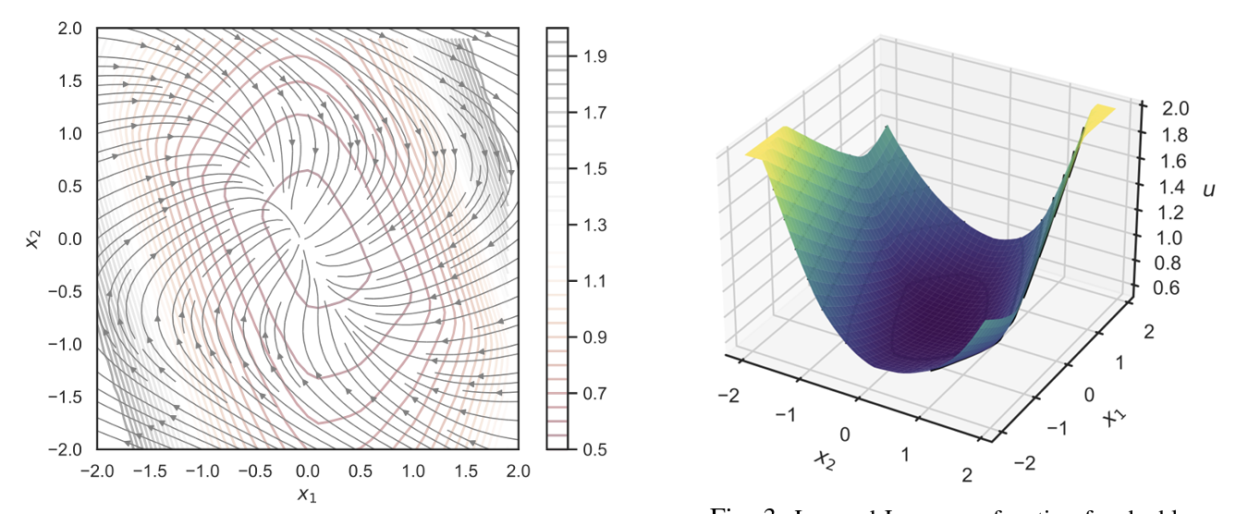
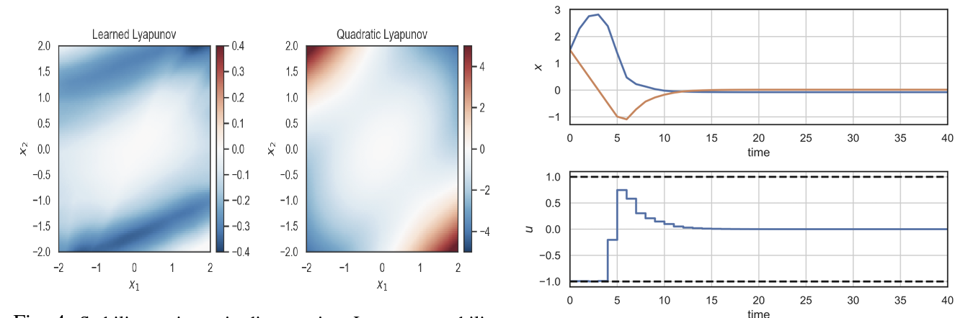
Learning Stable Policies via Neural Lyapunov Differentiable Predictive Control
Sayak Mukherjee, Ján Drgoňa, Aaron Tuor, Mahantesh Halappanavar, Draguna Vrabie, Neural Lyapunov Differentiable Predictive Control, arXiv:2205.10728, 2022

Slide 28
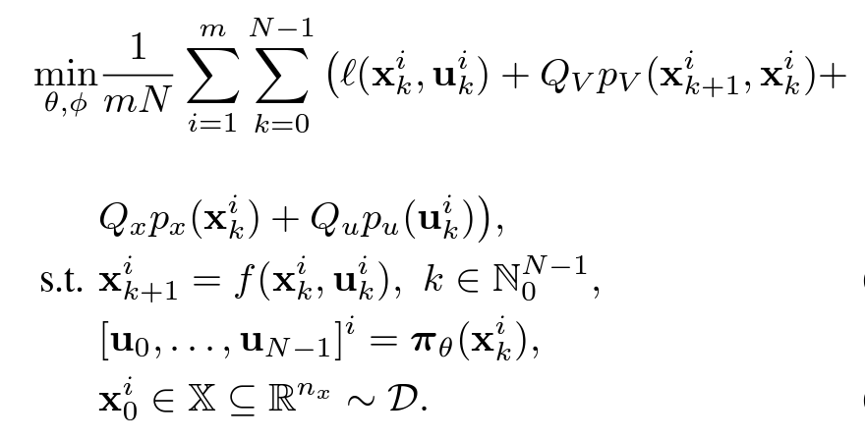
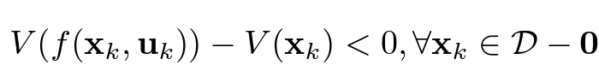
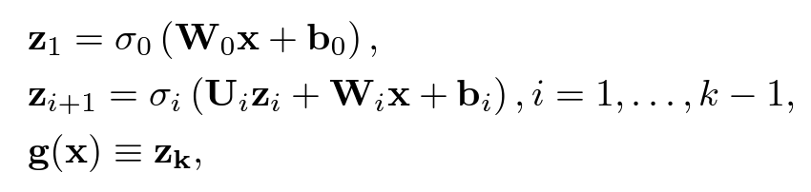
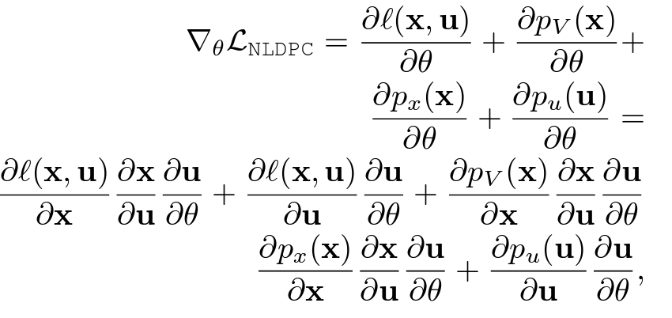
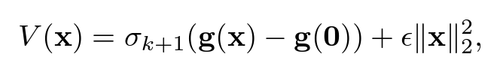
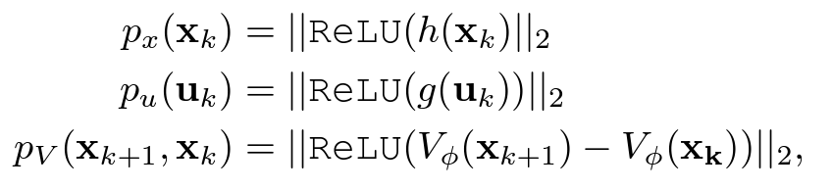
Learning Stable via Neural Lyapunov Differentiable Predictive Control
Neural Lyapunov Functions
Neural Lyapunov DPC
Lyapunov stability condition
Input-convex neural network
Trivial null-space via coordinate shift
Lyapunov regularization
Sayak Mukherjee, Ján Drgoňa, Aaron Tuor, Mahantesh Halappanavar, Draguna Vrabie, Neural Lyapunov Differentiable Predictive Control, arXiv:2205.10728, 2022
Gaurav Manek, J. Zico Kolter, Learning Stable Deep Dynamics Models, NeurIPS 2019.

